Slide 1
Computer Graphics & 3D
Kinect Avatar Animation
by Dott. Marco Pagliocca
Prof. Stefano Berretti

Slide 2
Overview
Introduction
Project goal
Solution idea
Environment details
Kinect
Kinect hardware
ToF advantages
ToF limitations
Using KinectSDK2 API
How to get body data
Avatar
OpenGL environment
Humanoid avatar
Joints
Camera & lights
Shaders
Animation
Routine functions
Animation idea
Filtering data errors
Outcomes
Test details
Video evidence
Comments
Computer Graphics & 3D - Kinect Avatar Animation by Dott. Marco Pagliocca - Prof. Stefano Berretti

Slide 3
Kinect Avatar Animation
Introduction

Slide 4
Project Goal
This project aims to use data from Kinect in order to animate a computer graphic avatar:
Step 1: acquire depth sequences with a Kinect camera and use the skeleton joints to animate a 3D avatar.
Step 2: use together 3D acquisition, skeleton, and computer graphics for visualization and rendering.
Avatars can be animated in a virtual OpenGL world by using Kinect camera capturing as input.
Moving in front of a Kinect depth sensors, it detects a body skeleton, which is then used to animate the avatar.
Computer Graphics & 3D - Kinect Avatar Animation by Dott. Marco Pagliocca - Prof. Stefano Berretti

Slide 5
Solution Idea
The solution requires:
choosing the programming language and Kinect framework
using Kinect API to get body information (skeleton)
modeling the 3D world and the avatar with OpenGL
linking Kinect data to avatar movements
Computer Graphics & 3D - Kinect Avatar Animation by Dott. Marco Pagliocca - Prof. Stefano Berretti

Slide 6
Environment Details
Operating System:
IDE:
Programming language:
Graphics library:
Kinect framework:
Windows 10 Home
Visual Studio 2019 Environments
C++
OpenGL
KinectSDK2 API
Computer Graphics & 3D - Kinect Avatar Animation by Dott. Marco Pagliocca - Prof. Stefano Berretti
Notes:
Add motivations of chooses

Slide 7
Kinect Avatar Animation
Kinect

Slide 8
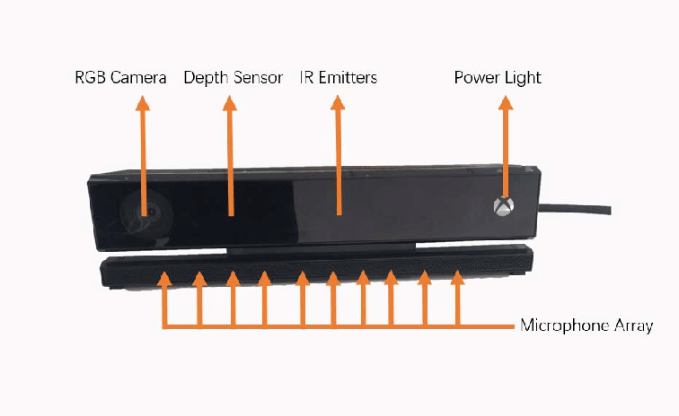
Kinect Hardware
This project uses the second Kinect version (Kinect v2) for Xbox One and Microsoft Systems
Depth image of resolution 512 x 424 pixels
RGB image (1920 x 1080 pixels - 30 fps)
Range from 0.4 to 8 meters
Body tracking informations
Time-of-Flight technology
Microsoft Kinect v2 - sensors
Computer Graphics & 3D - Kinect Avatar Animation by Dott. Marco Pagliocca - Prof. Stefano Berretti

Slide 9
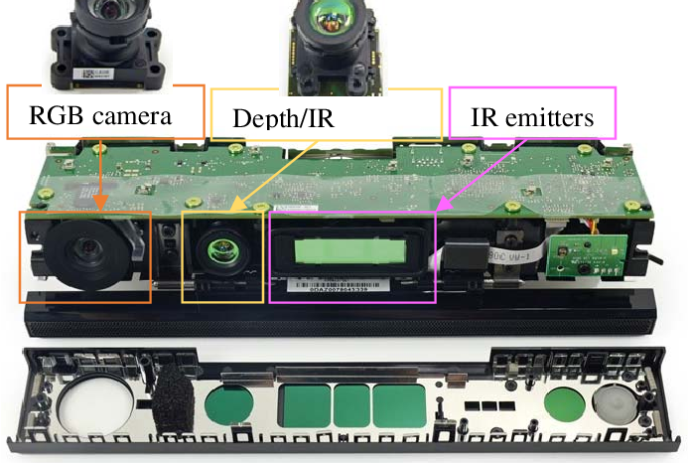
ToF Advantages
ToF cameras determine the depth by measuring the time emitted light takes from the camera to the object and back
Simplicity
Efficient distance algorithm
Object detection
Speed
Real-time applications
Internal structure of Microsoft Kinect v2
Computer Graphics & 3D - Kinect Avatar Animation by Dott. Marco Pagliocca - Prof. Stefano Berretti

Slide 10
ToF Limitations
Technology limitations caused by using integrating ToF cameras:
Influence of radiations
Background light
Temperature of the device
Influence of object color
Use only colors with similar reflectivity
Influence of camera distance
Accuracy is constant, precision decreases moving away the center
Per-pixel noise behavior
Oliver Wasenm ̈uller and Didier Stricker - Comparison of Kinect v1 and v2 Depth Images in Terms of Accuracy and Precision
Computer Graphics & 3D - Kinect Avatar Animation by Dott. Marco Pagliocca - Prof. Stefano Berretti

Slide 11
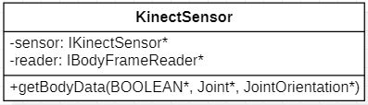
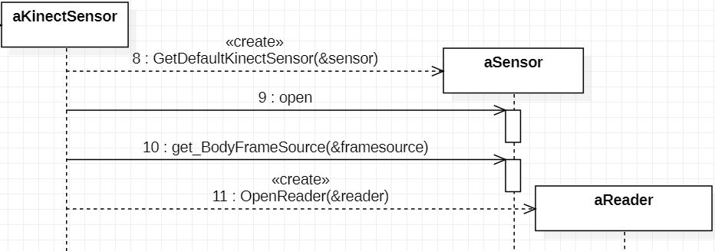
Using KinectSDK2 API
Kinect functionalities are encapsulated into KinectSensor class
Kinect Class Diagram
Object instantiation:
Find Kinect sensor
Initialize the sensor
Request the framesource from sensor interface
Open the reader from framesource
Kinect initialization Sequence diagram
Computer Graphics & 3D - Kinect Avatar Animation by Dott. Marco Pagliocca - Prof. Stefano Berretti

Slide 12
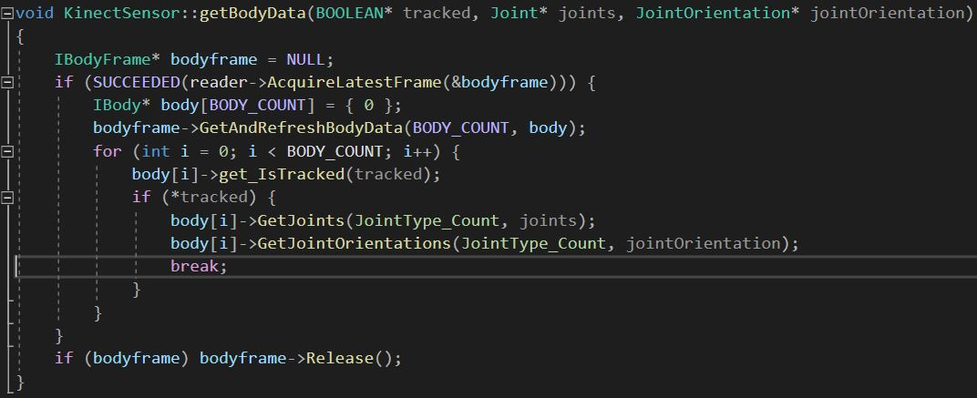
How To Get Body Data
KinectSensor’s getBodyData method
Kinect v2 can track up to 6 (BODY_COUNT) people simultaneously
Kinect v2 can track 25 (JointType_Count) joints
Computer Graphics & 3D - Kinect Avatar Animation by Dott. Marco Pagliocca - Prof. Stefano Berretti

Slide 13
Kinect Avatar Animation
Avatar

Slide 14
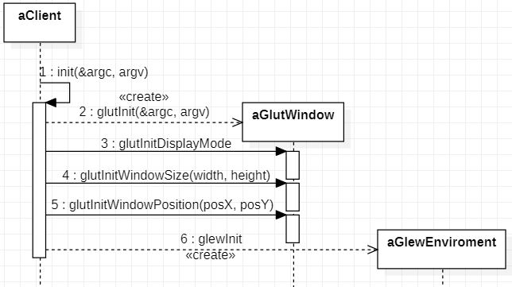
OpenGL Environment
OpenGL is a programming API for 3D computer graphic.
OpenGL Shading Language
Vertex shader
Fragment shader
Extension Mechanism
GLEW
Managing windows creation
FreeGLUT
Managing matrices
GLM
Sequence Diagram for GLUT and GLEW initialization
Computer Graphics & 3D - Kinect Avatar Animation by Dott. Marco Pagliocca - Prof. Stefano Berretti

Slide 15
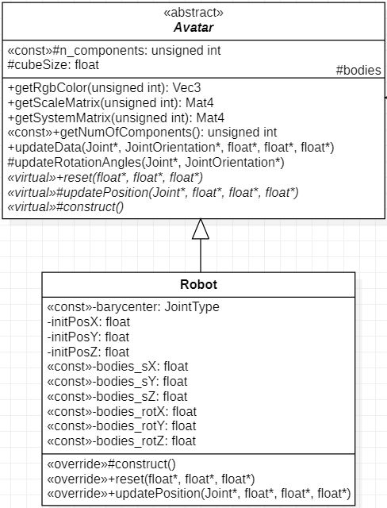
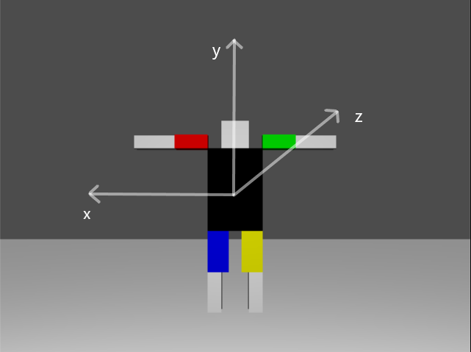
Humanoid Avatar
The avatar could be every class derived from Avatar.
In this project a humanoid robot is chosen
contains the main parts of human body (head, arms, forearms, thighs and legs)
OpenGL Avatar created for the project
Class Diagram for Avatar and Robot
Computer Graphics & 3D - Kinect Avatar Animation by Dott. Marco Pagliocca - Prof. Stefano Berretti

Slide 16
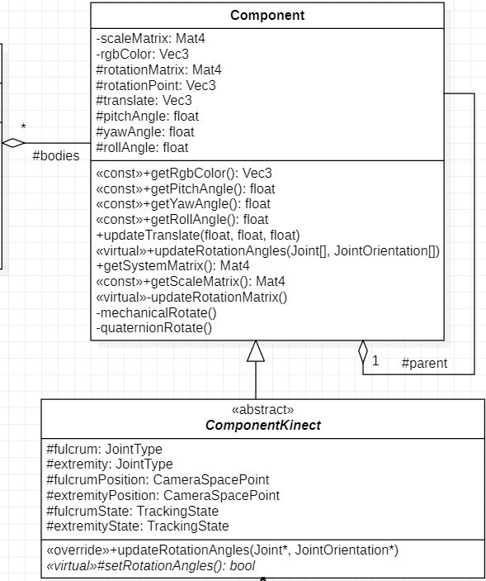
Joints
Every joint:
is a cube scaled and translated
has a parent joint, from which it depends on (except for body)
has a color
memorizes its angles and point of rotation
contains attributes and override methods for managing rotations with Kinect data
Class Diagram for Component and ComponentKinect
Computer Graphics & 3D - Kinect Avatar Animation by Dott. Marco Pagliocca - Prof. Stefano Berretti

Slide 17
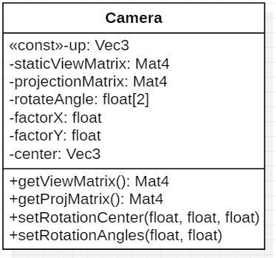
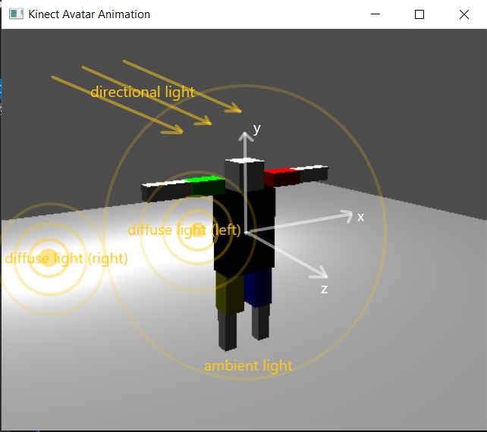
Camera & Lights
The Camera class instantiation sets the projection and the initial view matrices.
Class Diagram for Camera
FoV 45°
Near plane 0.4
Far plane 8
Width 512
Height 424
4 different light sources:
2 diffuse lights
1 directional light
1 ambient light
OpenGL avatar with light sources
Computer Graphics & 3D - Kinect Avatar Animation by Dott. Marco Pagliocca - Prof. Stefano Berretti

Slide 18
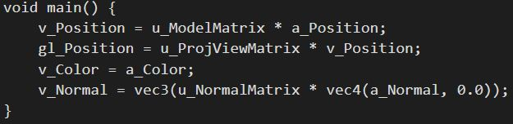
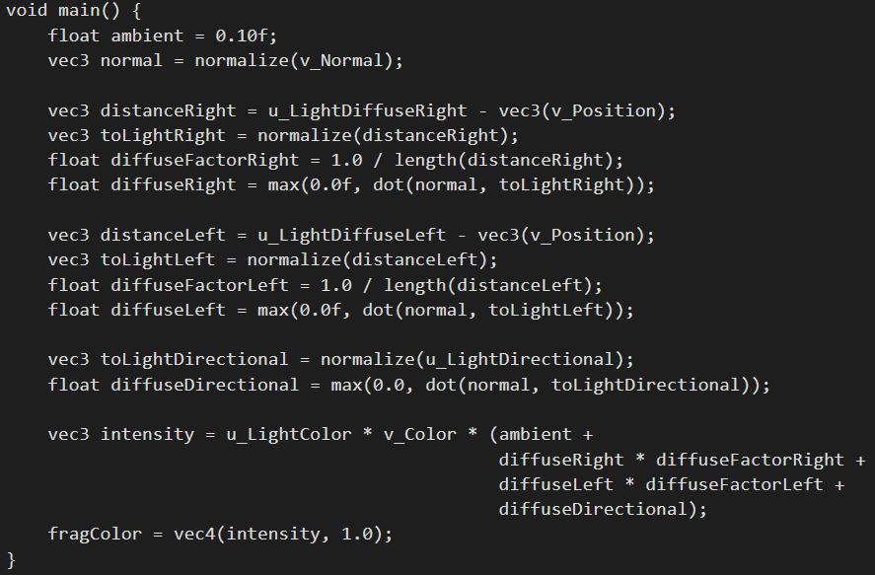
Shaders
Vertex shader
Other shader details:
Fragment:
diffuse factor
light color
Vertex:
different position
model matrix
proj-view matrix
normal matrix
Fragment shader
Computer Graphics & 3D - Kinect Avatar Animation by Dott. Marco Pagliocca - Prof. Stefano Berretti

Slide 19
Kinect Avatar Animation
Animation

Slide 20
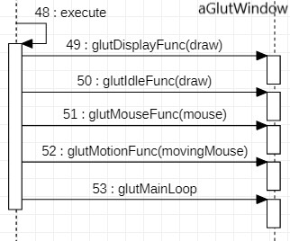
Routine Functions
glutDisplayFunc sets the display callback
draw function calls routines for refreshing and drawing
glutIdleFunc for continuous animation
glutMouseFunc sets the mouse callback
mouse function memorizes mouse position if clicked
Sequence diagram for event handler initialization
glutMotionFunc sets the motion callback
movingMouse function calculates rotation angles if mouse is clicked
glutMainLoop enters the GLUT event processing loop
Computer Graphics & 3D - Kinect Avatar Animation by Dott. Marco Pagliocca - Prof. Stefano Berretti

Slide 21
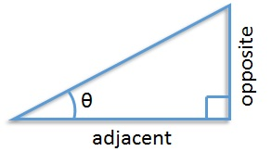

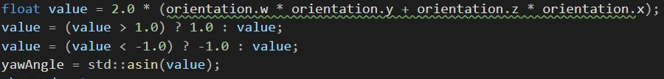
Animation Idea – Calculate Real World Angles
Using 2 Kinect sensor joint’s positions (arm, forearm, leg, thigh)
fulcrumPosition = joints[fulcrum].Position;
extremityPosition = joints[extremity].Position;
inverse tangent function: atan2(opposite, adjacent)
Using Kinect sensor joint’s orientation (body, head)
orientation = jointOrientation[extremity].Orientation;
Using orientation for defining yaw angle
Computer Graphics & 3D - Kinect Avatar Animation by Dott. Marco Pagliocca - Prof. Stefano Berretti

Slide 22
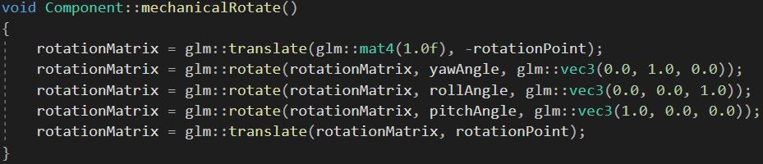
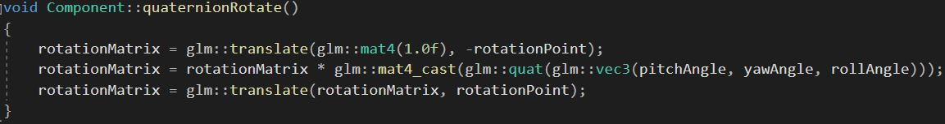
Animation Idea – Apply Rotations To The Avatar
using Euler angles
Implementation of Euler rotation
using Quaternions
Implementation of Quaternion rotation
Computer Graphics & 3D - Kinect Avatar Animation by Dott. Marco Pagliocca - Prof. Stefano Berretti

Slide 23
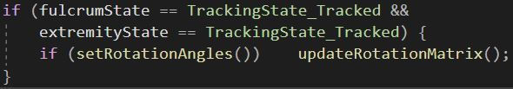
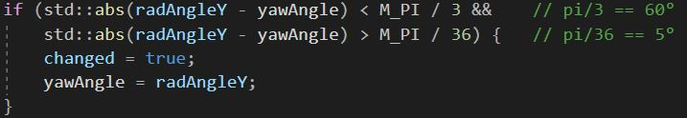
Filtering Data Errors
Using Kinect joint’s tracking states
fulcrumState = joints[fulcrum].TrackingState;
extremityState = joints[extremity].TrackingState;
Filtering tracking errors
Limitations on two successive rotations:
instant movements are unnatural and probably tracking errors
too small movements are unnecessary and probably noise errors
user has to start in standing up and with open arms
Filtering abnormal rotations
Computer Graphics & 3D - Kinect Avatar Animation by Dott. Marco Pagliocca - Prof. Stefano Berretti

Slide 24
Kinect Avatar Animation
Outcomes

Slide 25
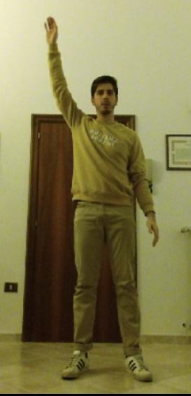
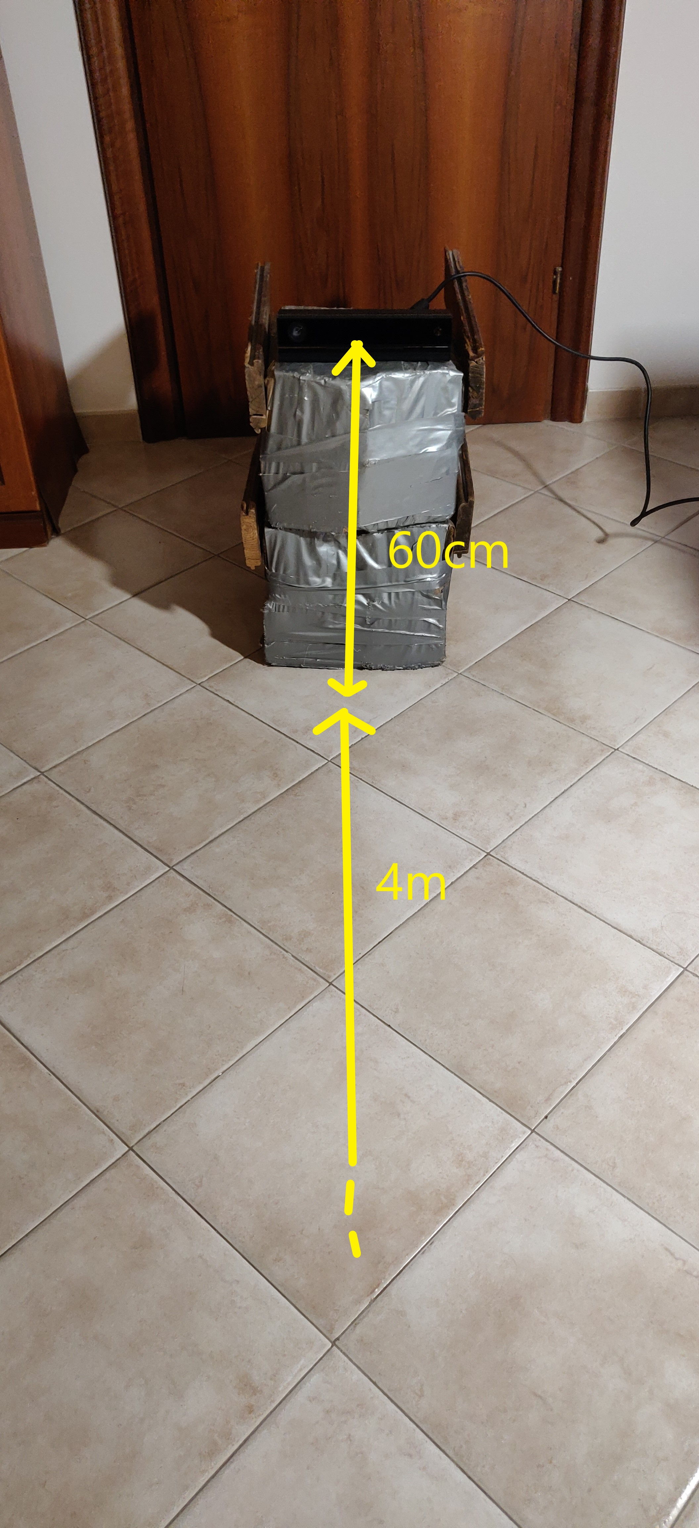
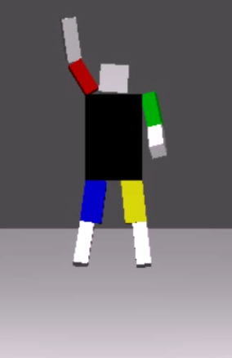
Test Details
Avoided external light’s sources in front of Kinect
Kinect runned 25 min
Kinect placed:
4 meters from user
at half-bust level
User
positioned in front of Kinect
wearing similar colored clothes
Kinect Avatar Animation test images. On the right, some position informations. In the middle, a user moving in front of the Kinect. On the left, the avatar animated by user movement.
Computer Graphics & 3D - Kinect Avatar Animation by Dott. Marco Pagliocca - Prof. Stefano Berretti

Slide 26
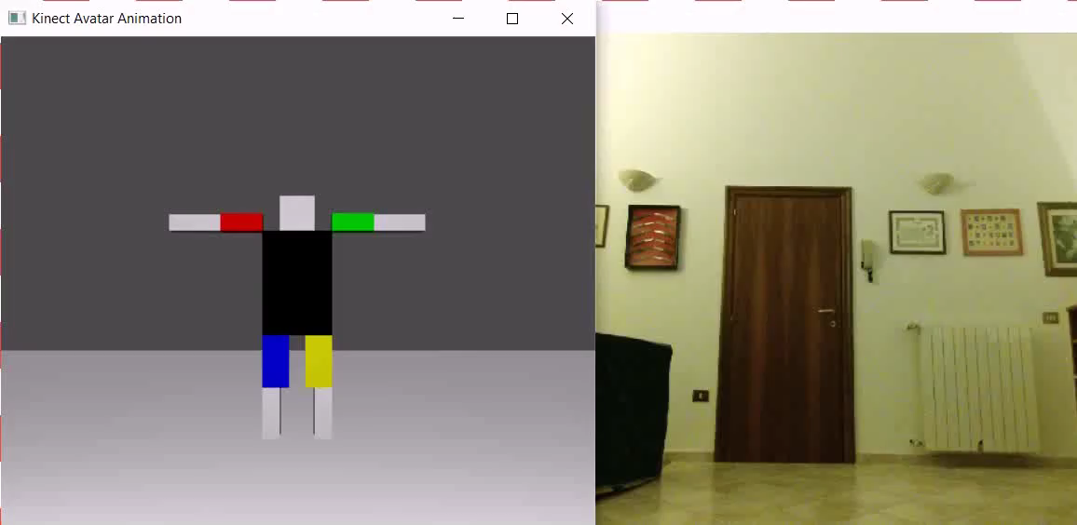
Video Evidence
Computer Graphics & 3D - Kinect Avatar Animation by Marco Pagliocca - Prof. Stefano Berretti

Slide 27
Comments
User has to start in standing up and with open arms
Simple joints movements are captured and animated correctly
Natural movements are animated correctly most of the time
or the avatar returns in the right position as soon as possible
Elasticity tests show that angle calculations are consistent with real movements even if occlusion problems occurred
When animation is corrupted, user can come out from the Kinect area
the robot backs to starting position when nobody is tracked
Computer Graphics & 3D - Kinect Avatar Animation by Dott. Marco Pagliocca - Prof. Stefano Berretti

Slide 28
Thanks for your attention
Computer Graphics & 3D
Kinect Avatar Animation
Dott. Marco Pagliocca
marco.pagliocca@stud.unifi.it
Computer Graphics & 3D - Kinect Avatar Animation by Dott. Marco Pagliocca - Prof. Stefano Berretti

